Slide 1

Verilog
Finite Basics
By Layth Sattam

Slide 2
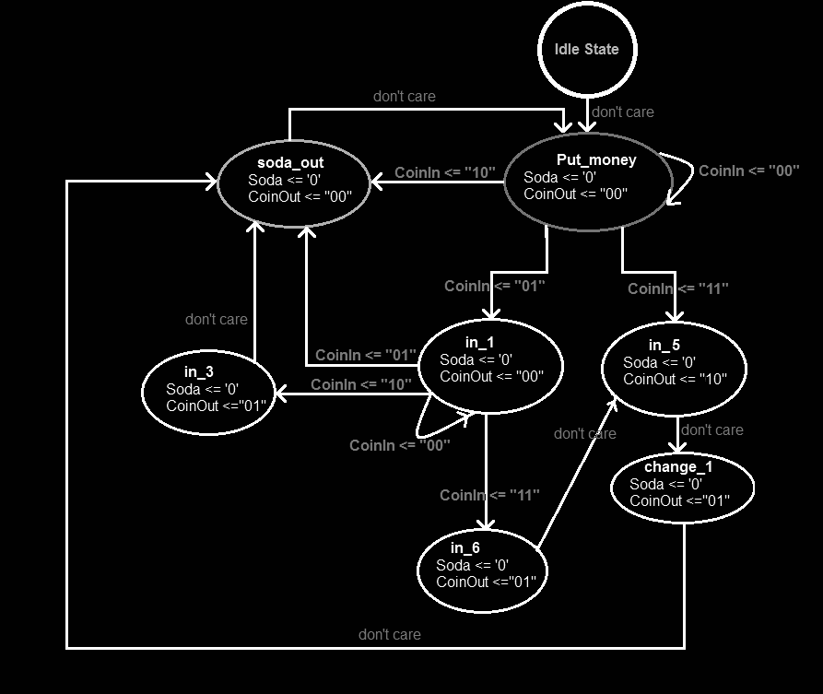
What is a Finite STate Machine?
A Finite State Machine (FSM) is a computational model used to design systems that can transition from one state to another based on inputs it receives. It is called "finite" because it has a limited number of possible states.
Some basic components include:
States: Distinct modes or conditions the system can be in.
Initial State: The state the system begins in when it starts operating.
Inputs: Signals or events that can affect the system’s behavior.
Transitions: Rules that determine how the system moves from one state to another based on inputs.
Outputs: Actions or signals the system produces, often based on the current state and/or input.

Slide 3

Types of Finite State Machines
1
Moore
2
Mealy
Output depends only on the current state.
Outputs change only when the FSM transitions to a different state.
Simpler and easier to design and debug.
Output depends on both the current state and the current input.
Outputs can change immediately in response to inputs, even if the state doesn't change.
Typically reacts faster, but can be more complex.

Slide 4
Design a Finite State Machine in Verilog that uses the inputs start, abort, and timer to control a launch sequence, where the system counts down from a set timer, can be interrupted by an abort signal, and sets an output signal, launch, when the countdown completes.

Slide 5
Inputs:
start - 1b
reset - 1b
Outputs:
launch - 1b
Variables:
timer - 4b
States(2b):
Init
Count
Fly
Count
Down
reset’
start
Launch = 0
timer--
Timer == 0
start’
reset
Init
Fly
Launch = 0
timer = 10
Launch = 1

Slide 6

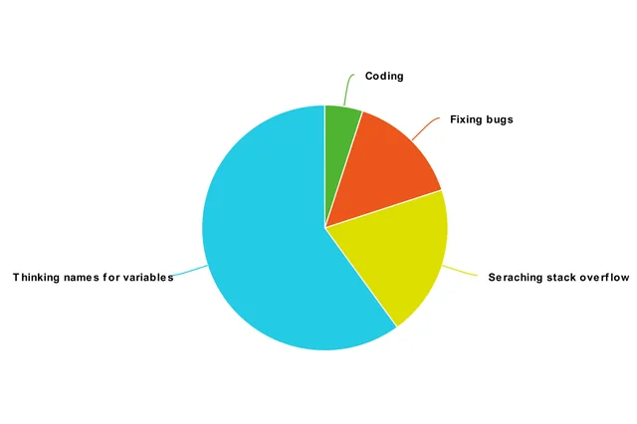







Beep Boop Programming

Slide 7
Thank
You!

